Slide 1
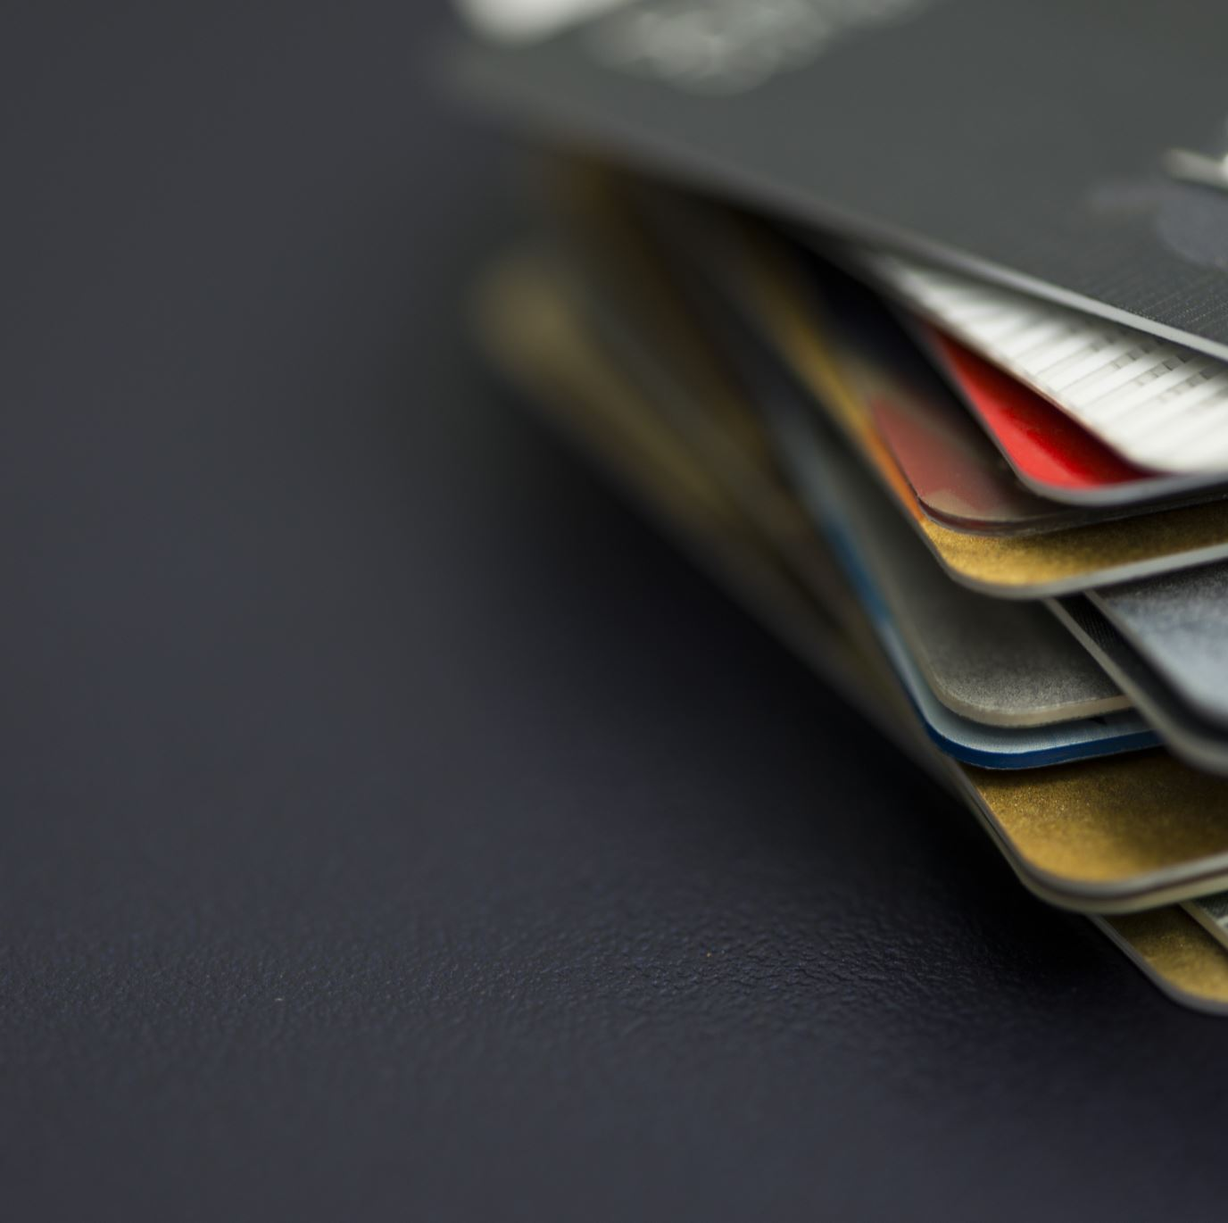
Credit Card Transactions Fraud Detection
Group 5
Hemanth (14411094 )
Bindu ( 16338568 )
Teja ( 16336900 )

Slide 2
Introduction
Our objective is to develop an advanced system to detect and prevent credit card fraud, ensuring peace of mind for cardholders.
Why It Matters:
Credit card fraud poses a significant threat to individuals and financial institutions, causing substantial losses each year.
Credit Card Fraud Statistics (2023)
46% of global credit card fraud happens in the US
Credit card fraud worldwide will reach $43 billion by 2026
US credit card fraud losses will eclipse $12.5 billion by 2025
48% of consumers say it’s the merchant’s responsibility to protect them from fraud
55% of fraudulent credit and debit card transactions are less than $100
Every 14 seconds, a person in the US falls victim to identity theft

Slide 3
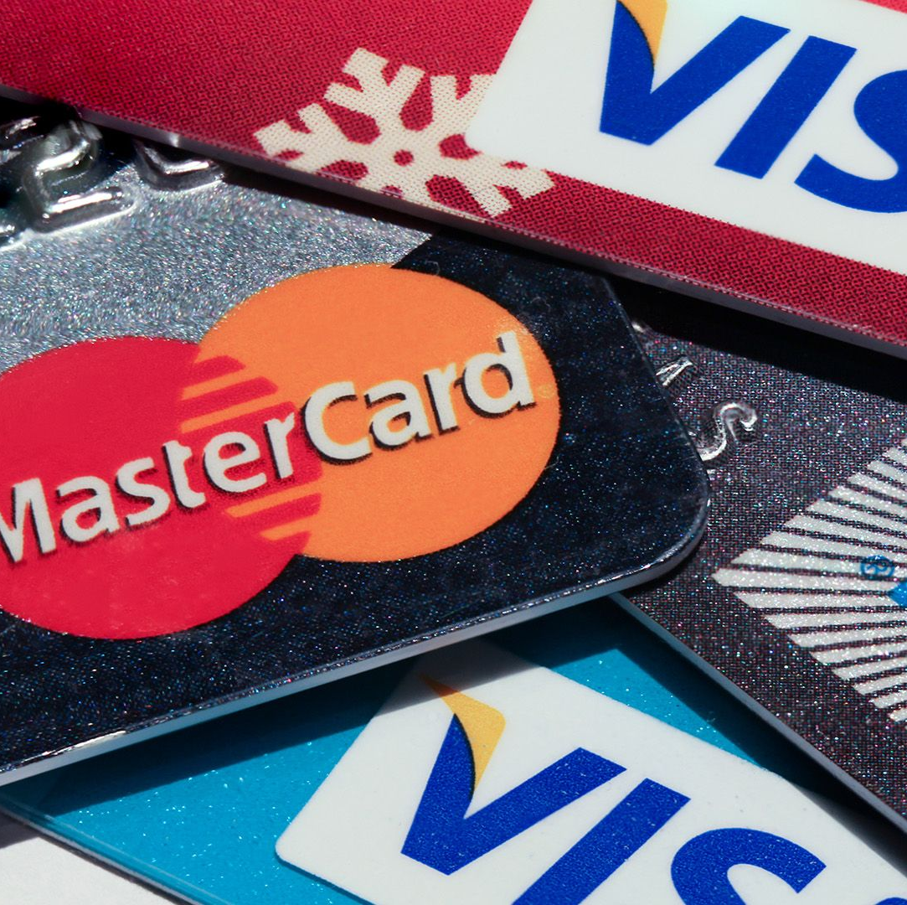
Dataset: https://www.kaggle.com/datasets/kartik2112/fraud-detection
Name : Credit Card Fraud Transaction detection
Dimension : 1.3 million * 23
Data Size : 502 MB
No of Columns : 23
Columns : Trans date, CC_Num, Merchant, Category, Amt, Gender, Name ,City, State, Zip, Job etc.
Date: 1 Jan 2019 to 31 Dec 2020.

Slide 4
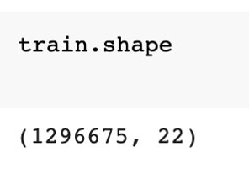
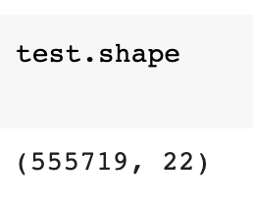
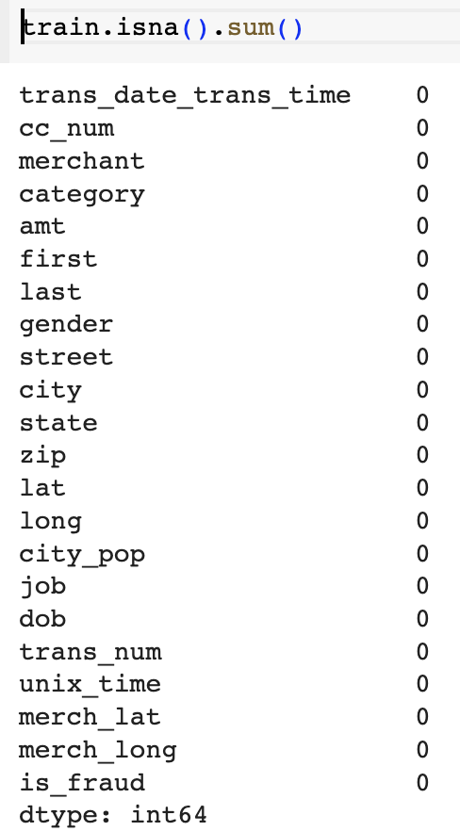
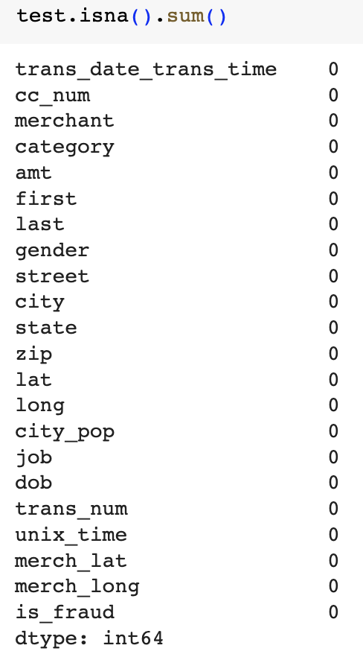
Exploratory Data Analysis
Data Cleaning
Univariate Analysis
Bivariate Analysis
Data Visualization
Summary Statistics
Outlier Detection

Slide 5
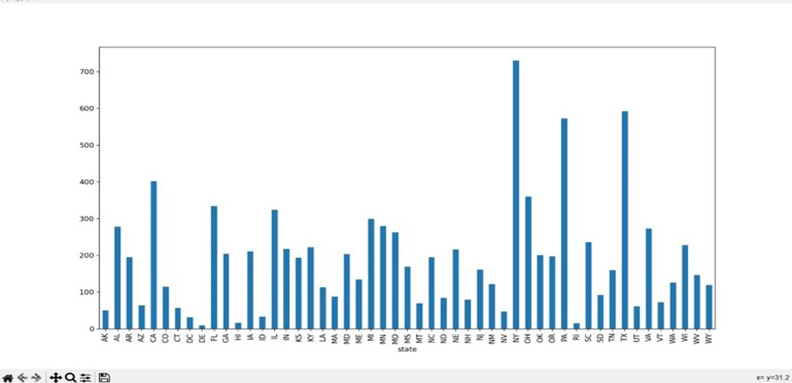
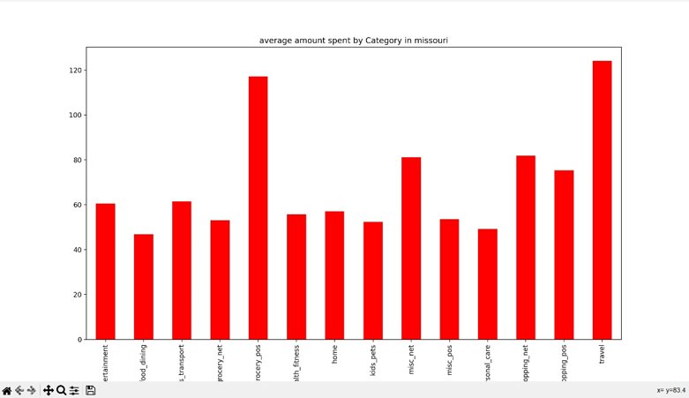
Preliminary Analysis
New York has highest recorded fraud transactions followed by Texas and Pennsylvania.
The number of fraud transactions is high for age group 50-60.
More number of fraud transactions were recorded at entertainment and grocery merchants.
In Missouri, travel is the most spent category followed by grocery.

Slide 6
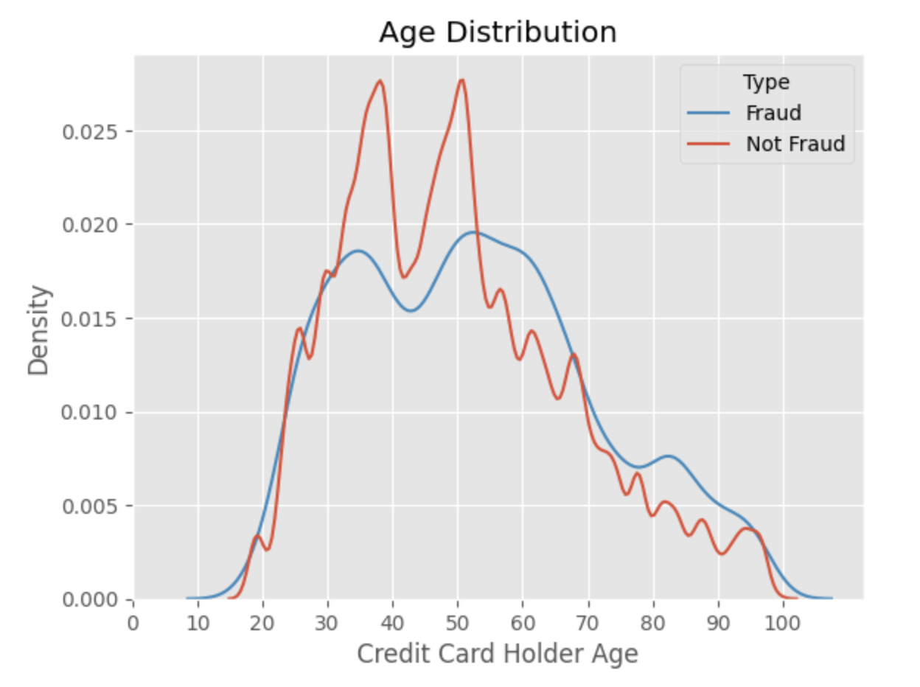
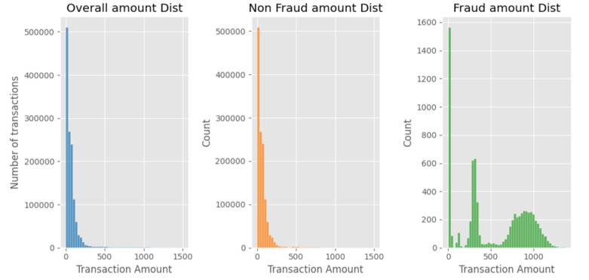
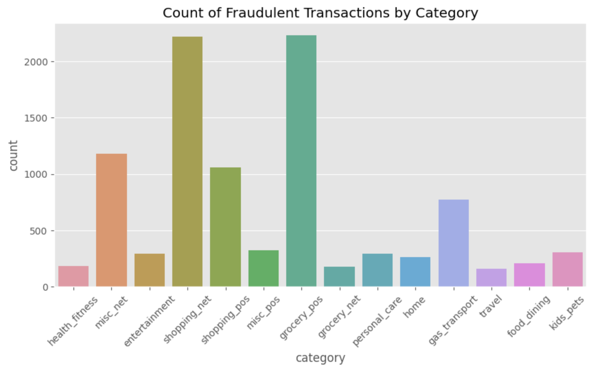
Preliminary Analysis

Slide 7
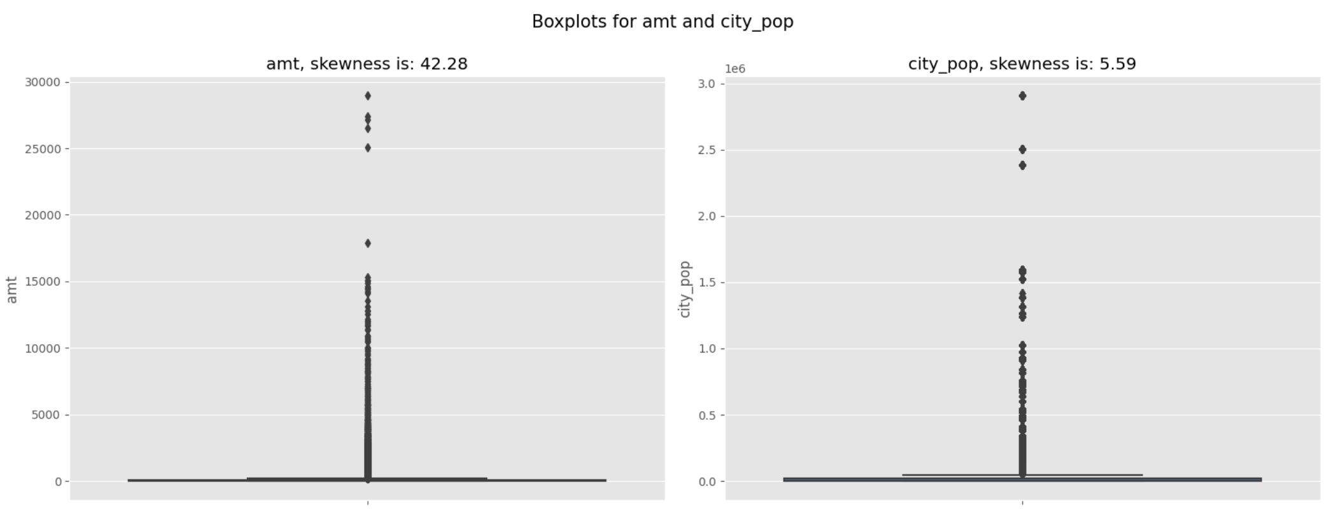
Preliminary Analysis
The dataset is strongly skewed to the right, as shown by a skewness score of 42.8, and it is possible that there are large values that are having a substantial impact on the distribution.
According to the above bar plot, the amount involved is high for the majority of fraudulent transactions.
Removal of outliers is not appropriate in this situation since they represent the highest risk of fraud.

Slide 8
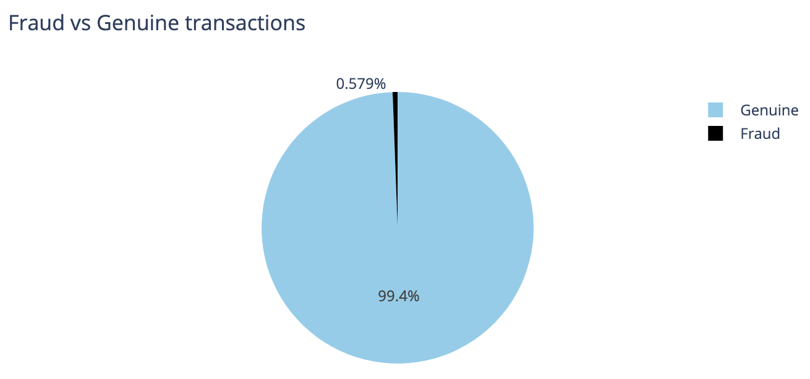
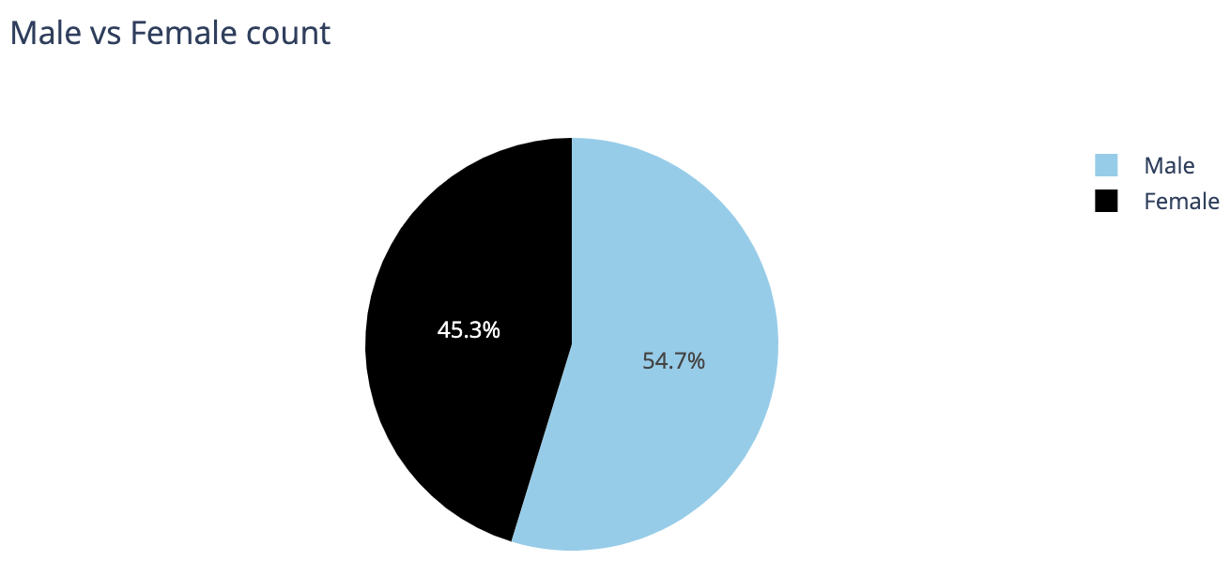
Class Imbalances and treatment Techniques
We can't use accuracy score as a metric with imbalanced datasets - it will be usually high and misleading. In this dataset, we have 99.4% of Genuine transactions and only 0.579% (579) of fraud transactions; which means that a blind guess (bet on Genuine) would give us accuracy of 99.4%.
Few techniques to avoid data and class imbalances were:
Under Sampling
Over Sampling
SMOTE(Synthetic Minority Over-sampling Technique)
Adasyn

Slide 9
Methodologies
Perform an exploratory data analysis on the data to understand which features might be correlated to fraudulent activities.
Dive Deep into the data to see if there is any missing values and any skewness, class imbalances etc.
Then Attempt to create models with those features and test out their predictive effectiveness.
Understand the characteristics of a fraudulent transaction and develop predictive models accordingly to flag down potentially risky activities for fraud prevention.
Build a scalable model i.e., ready to deploy.

Slide 10
Methodologies
Recurrent Neural Networks (RNNs):
RNNs, such as LSTM (Long Short-Term Memory) or GRU (Gated Recurrent Unit), are well-suited for sequential data like time series.
We can use RNNs to model the temporal dependencies in your dataset, which can be important for detecting fraud patterns over time.
Autoencoders:
Autoencoders are neural networks used for dimensionality reduction and feature learning. They can help in identifying unusual patterns in the data.
We can build an autoencoder to reconstruct the input data and then use the reconstruction error as an anomaly score for fraud detection.
Deep Neural Networks (DNNs):
Traditional feedforward neural networks (DNNs) can also be effective for tabular data.
We can create a deep neural network architecture with multiple layers and employ techniques like dropout to prevent overfitting.

Slide 11
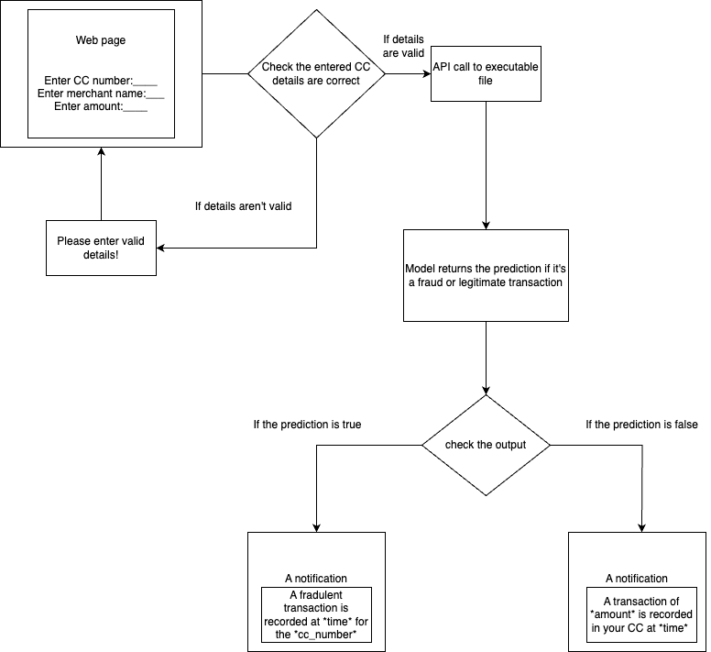
Conceptual Diagram

Slide 12
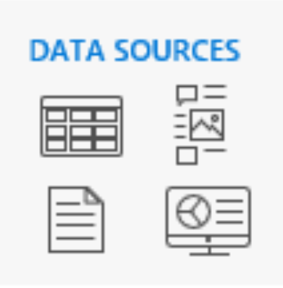
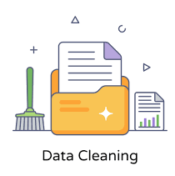
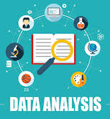
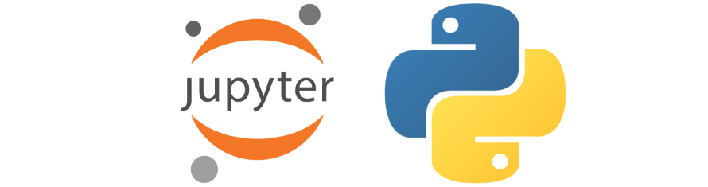
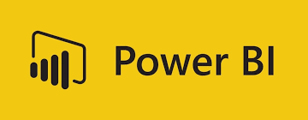
Architecture
Output
Modelling

Slide 13
Timelines and Roadmap
Data Analysis, Model implementation & Evaluations : October
Data Finalization , Model Finetuning, optimizations : November
Documentation, Visualizations and Final Presentation : December

Slide 14
Q & A

